Slide 1
Breast Cancer Detection and Development of its Recurrence Prediction Model Using Machine Learning Techniques
Presented by:- ANJALI KISHEN (BE/15189/16) and
TRIPNA MEHTA (BE/15279/16)
UNDER THE GUIDANCE OF :- Prof. SHEEL SHALINI

Slide 2

Introduction: what is machine learning AND WHY WE ARE USING IT ?
Machine Learning (ML) is the subfield of computer science that "gives the computer ability to learn without being explicitly programmed." Machine Learning allows developers to build algorithms that automatically improve themselves by finding patterns in the existing data without explicit instructions from a human or developer.

Slide 3
Breast cancer: an overview
• Breast cancer is the second leading cause of cancer death in women, second only to lung cancer.
• The leading risk factor for breast cancer is simply being a woman. Though breast cancer does occur in men, the disease is 100 times more common in women.
• Men can also get breast cancer. In 2017, the American Cancer Society estimates 2,470 new cases of invasive breast cancer will be diagnosed in men in the U.S.
• A woman has about a one in eight chance of being diagnosed with breast cancer in her lifetime, according to the National Cancer Institute.
• Most women (about eight out of 10) who get breast cancer do not have a family history of the disease.
• But women who have close blood relatives with breast cancer have a higher risk. Having a first-degree relative (mother, sister or daughter) with breast cancer almost doubles a woman’s risk.

Slide 4
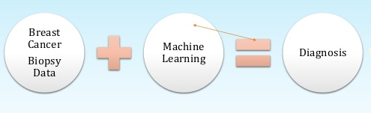
Why are we using machine learning?

Slide 5
Understanding the algo-
Classification and Regression Trees (CART),
Linear Support Vector Machines (SVM),
Gaussian Naive Bayes (NB) and
k-Nearest Neighbors (KNN).

Slide 6
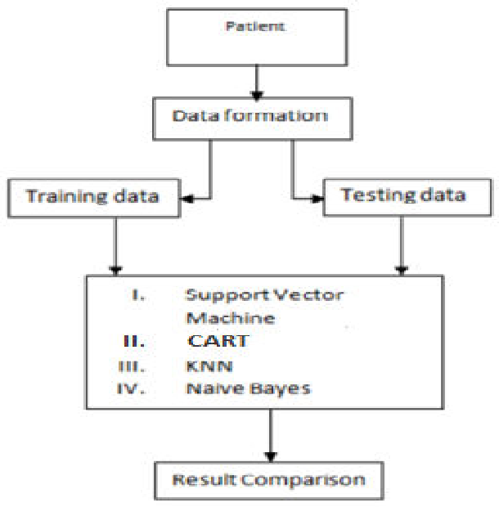
Flow chart

Slide 7
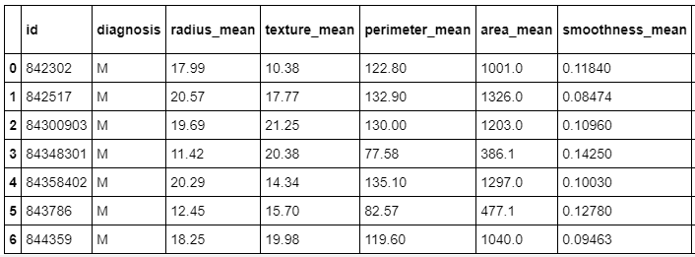
Data used in analysis:

Slide 8
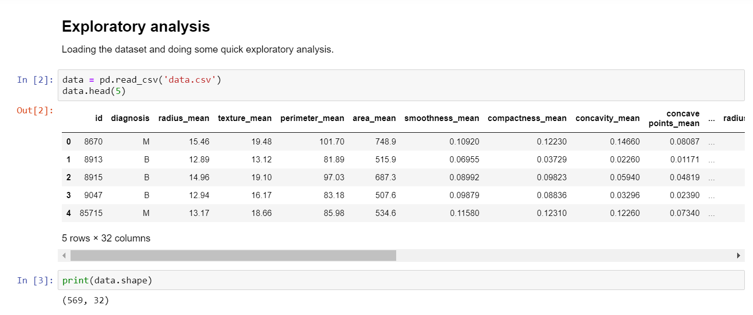
Analysis with Python language- step1-Exploratory analysis
1.collecting data
We will utilize the Wisconsin Breast Cancer Diagnostic dataset from the UCI Machine Learning Repository at http://archive.ics.uci.edu/ml. This data was donated by researchers of the University of Wisconsin. The breast cancer data includes 569 examples of cancer biopsies, each with 32 features.

Slide 9
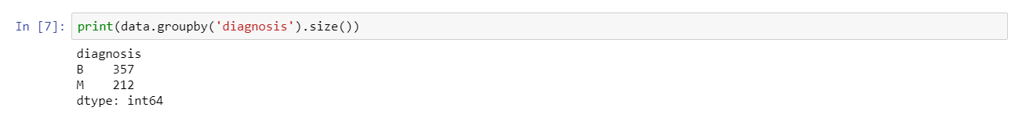
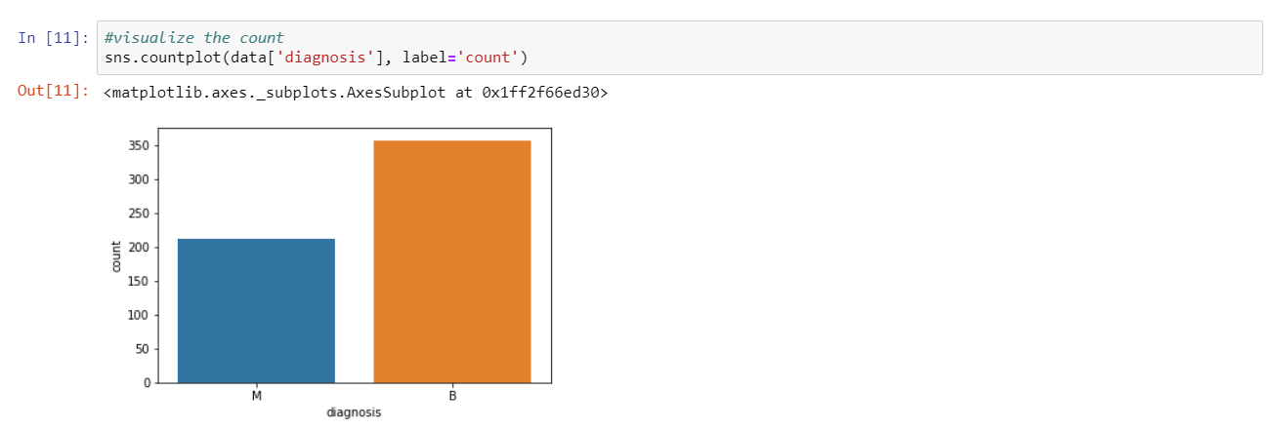
2. Exploring and preparing data
Importing the data set in Jupyter notebook using python language .
The table( ) output indicates that 357 masses are benign while 212 are malignant

Slide 10
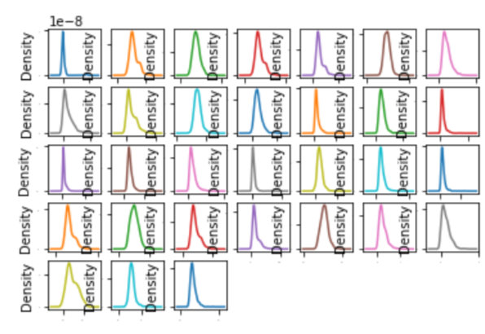
Visualization 1 we can visualize the data using density plots to get a sense of the data distribution. From the outputs below, you can see the data shows a general gaussian distribution.

Slide 11
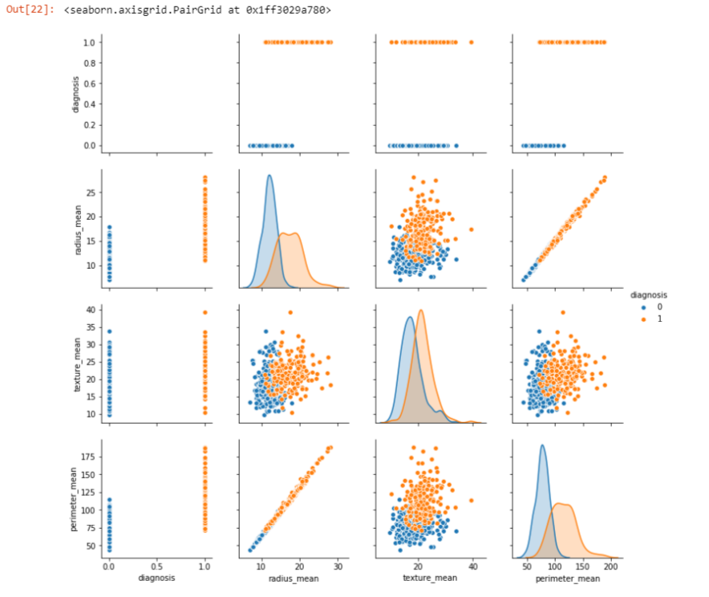
Visualization 2

Slide 12
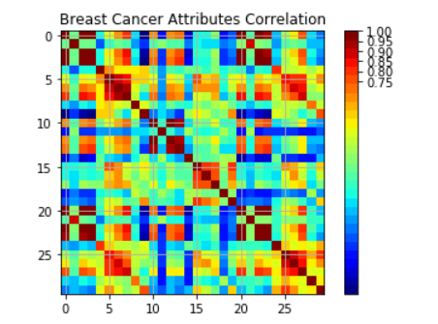
VISUALIZATION 3
Correlation Graph
From the output graph below, the red patches around the diagonal suggests that attributes are in positive correlation with each other. The yellow and green patches suggest some moderate correlation and the blue boxes show negative correlations.

Slide 13
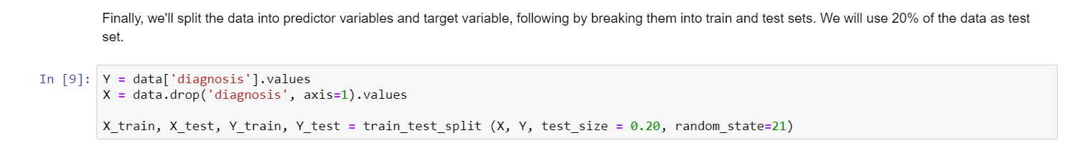
Step3- creating training and test datasets
Finally, we'll split the data into predictor variables and target variable, following by breaking them into train and test sets. We will use 20% of the data as test set.

Slide 14
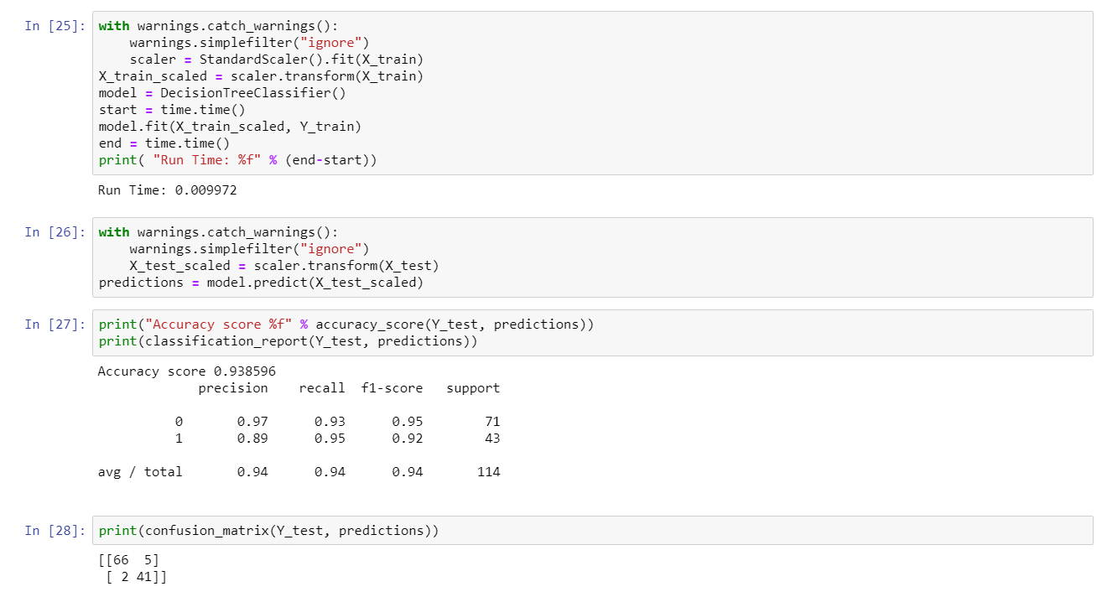
Confusion Matrix to calculate Accuracy 1.Dt confusion matrix

Slide 15
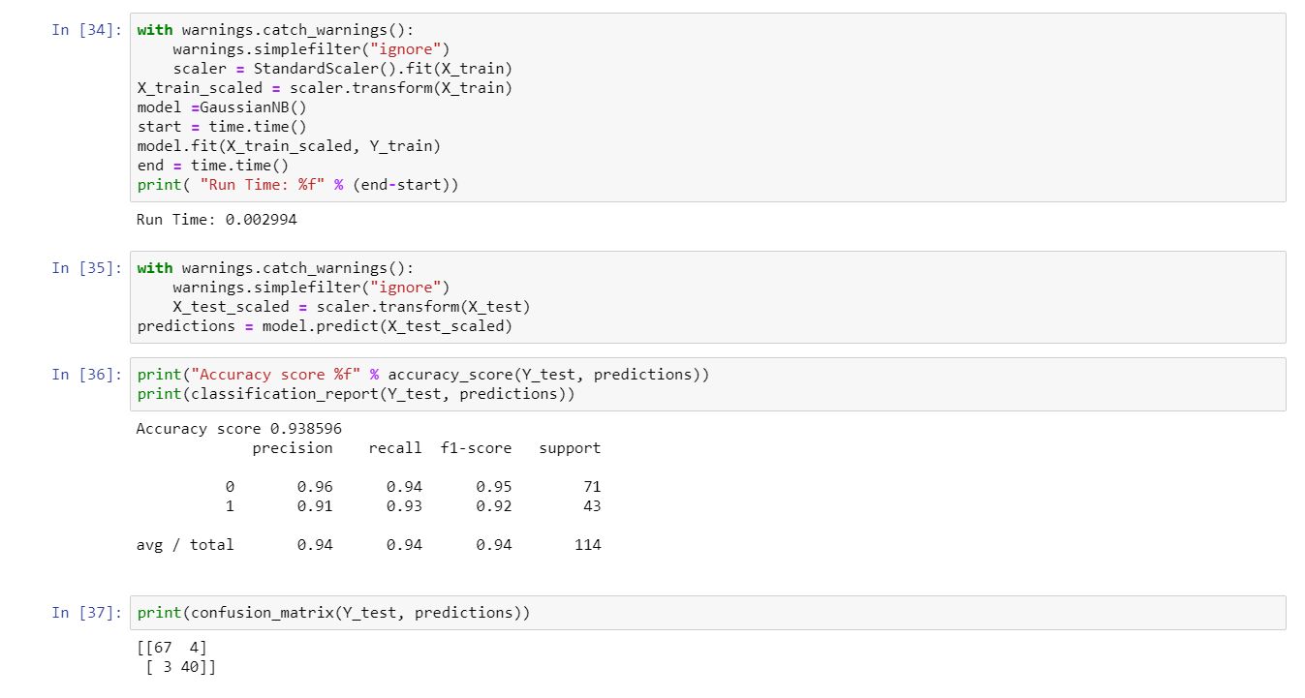
2. nb confusion matrix

Slide 16
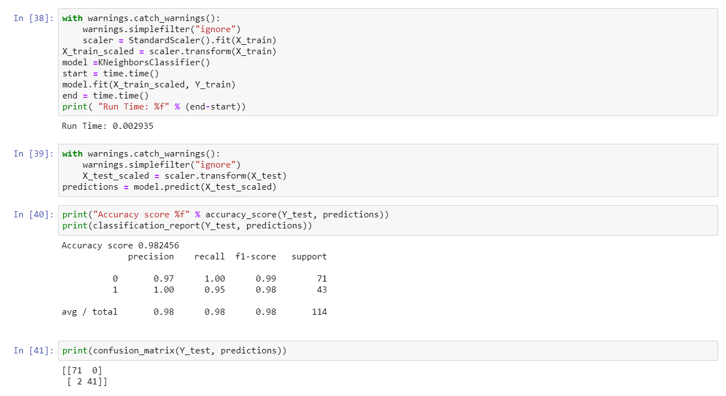
3. knn confusion matrix

Slide 17
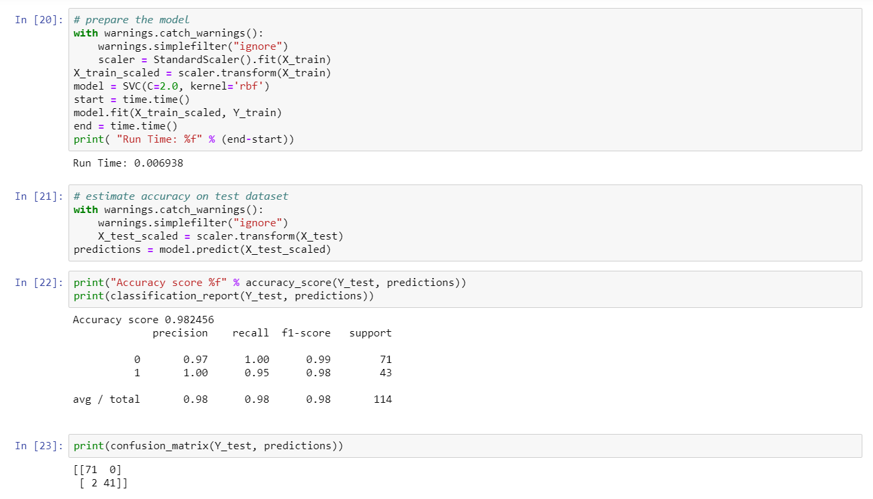
4. Svm confusion matrix

Slide 18
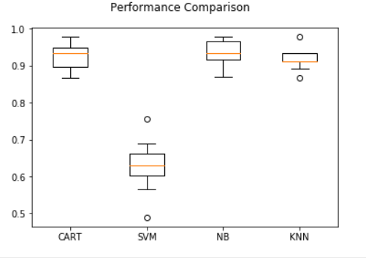
The performance comparison of the all four machine learning algorithms on non-scaled data:
FOLLOWING GRAPH Shows THAT :
the performance accuracy of CART IS 92%
the performance accuracy of SVM IS 62.9%.
performance accuracy of NB IS 93.6%.
the performance accuracy of KNN IS 91.8%.

Slide 19
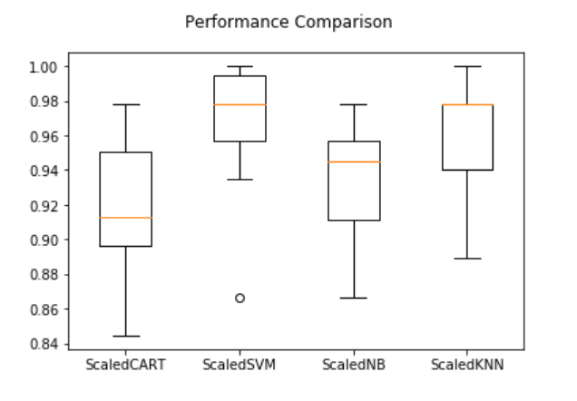
The performance comparison of the all four machine learning algorithms on standardised data:
The FOLLOWING analysis shows that accuracy of CART, NB, KNN and SVM are 0.909, 0.941, 0.978 and 0.989 respectively.

Slide 20
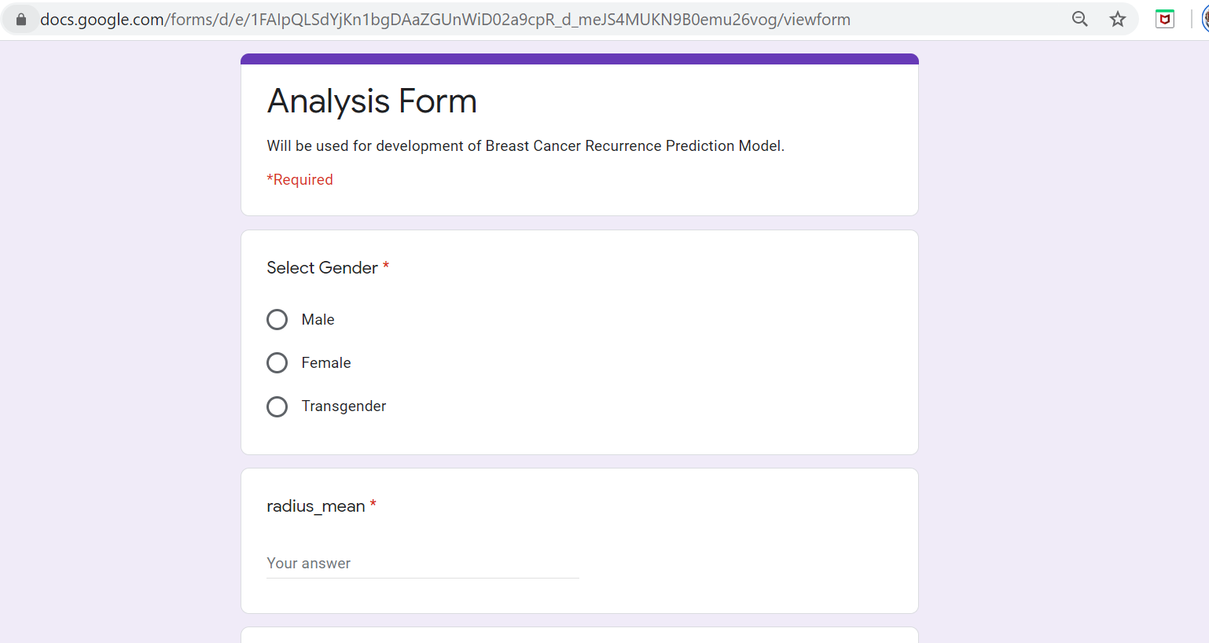
Survey for Development for Recurrence Prediction Model
Since we have no verified data for breast cancer recurrence prediction (based on the patient's medical inventory), we have conducted a survey about this.
https://docs.google.com/forms/d/e/1FAIpQLSdYjKn1bgDAaZGUnWiD02a9cpR_d_meJS4MUKN9B0emu26vog/viewform?usp=sf_link
LINK FOR THE SURVEY

Slide 21
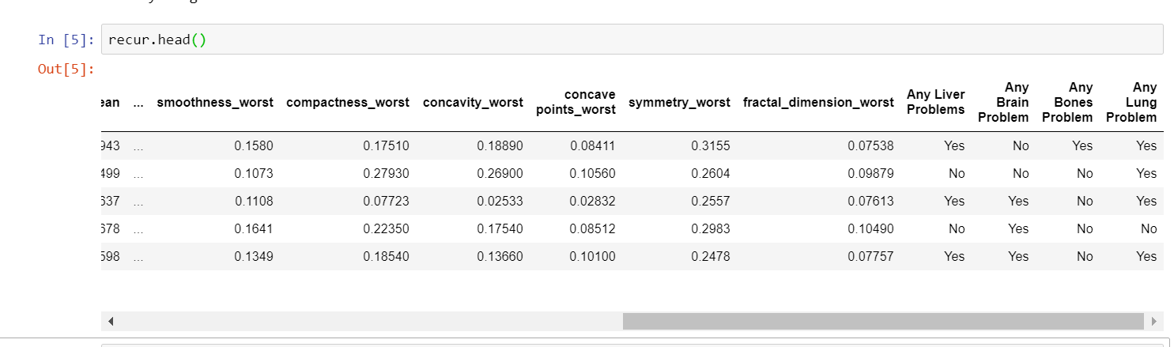
Data Retrieved FROM SURVEY -

Slide 22


